Slide 1

Li chun ming 210083096
IT114115 Higher Diploma in Cloud and Data Centre Administration (2B) ITP4103 Security Applications

Slide 2

Introduction
Our Final Year Project focuses on remote desktop on Ubuntu in Google Cloud Platform and Microsoft Azure
Remote desktop connections are increasingly popular
Additionally, we're integrating ChatGPT into our Minecraft server for an interactive gaming experience
ChatGPT AI model allows for natural language conversations, enhancing overall gameplay

Slide 3
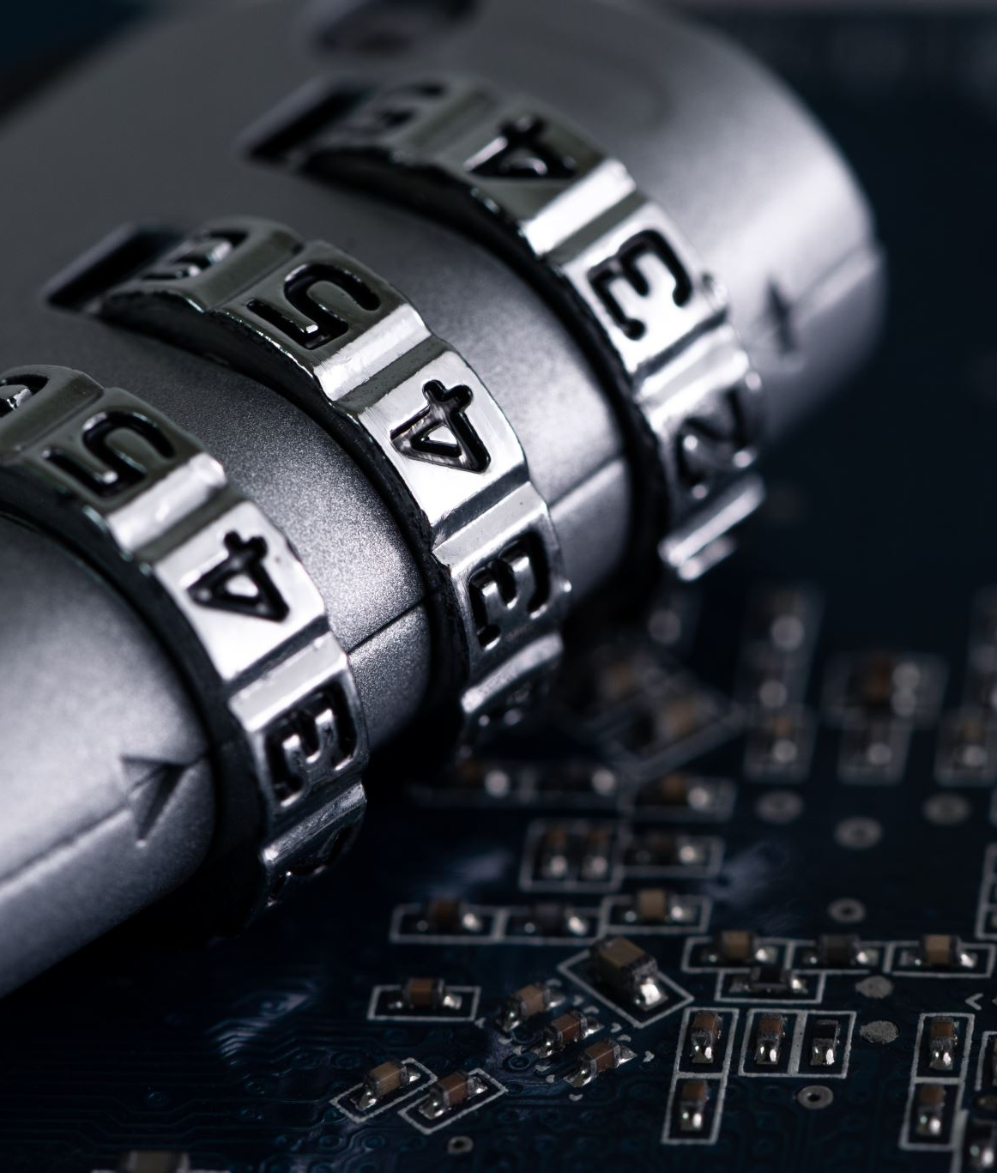
WHY?
- Security is a major concern due to sensitive data online.
- Cyber threats are frequent and sophisticated, making security essential.
- Inadequate security leads to data breaches and financial/legal issues.
- Cyber-attacks disrupt business operations and damage reputation.
- Poor security impacts individuals, businesses, and society.
- Prioritize security and continuously improve to stay ahead of cyber threats.

Slide 4
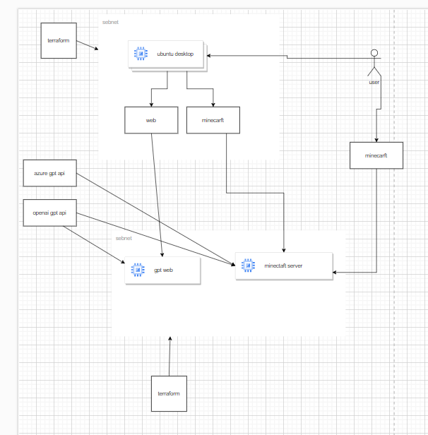
architecture
Terraform and CDKTerraform are used to create Ubuntu desktop instances on GCP and Azure.
Terraform is also used to create a Minecraft server and website on dedicated Ubuntu instances.
ChatGPT API is integrated into both the Minecraft server and website to allow users to interact with the ChatGPT AI model in natural language.

Slide 5
Vulnerability
VM accessible by IP by anyone
Password not randomly generated
Minecart server open to public
System bug or new vulnerability

Slide 6
Threat
Student's own behavior or mental state
Other people's actions or intentions
My self

Slide 7
risk
Password cracking, account compromise, identity theft
Unauthorized access, data theft, malware infection

Slide 8
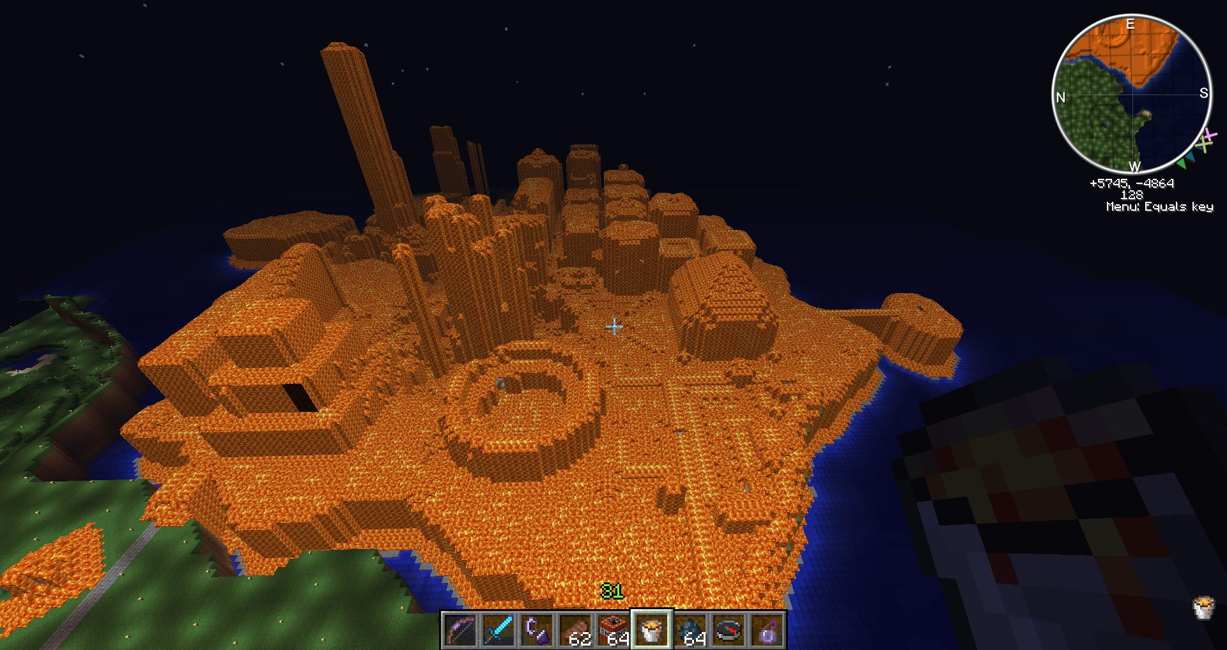
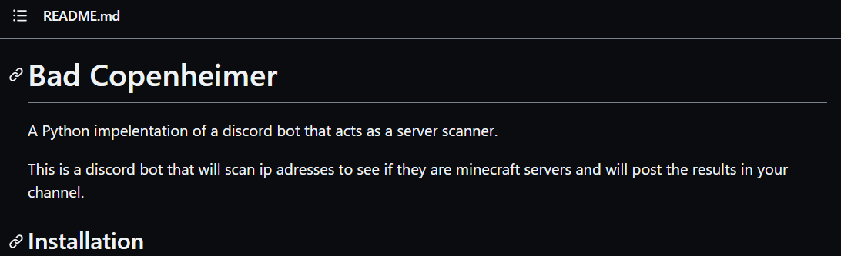
A common threat to Minecraft servers is the use of bots that scan and target them for “griefing”. “Griefing” is the act of destroying or stealing other players' creations or resources without their permission.

Slide 9

So what we have do to secure our system

Slide 10
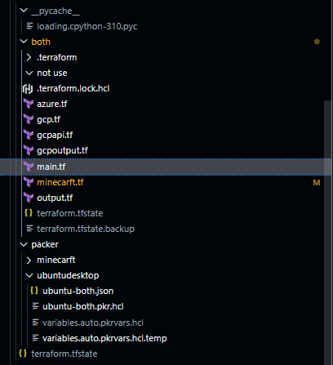
Protecting Sensitive Data on GitHub
To protect your sensitive data from being exposed on GitHub, you should use an env file to store it and a .gitignore file to prevent it from being uploaded. This way, you can keep your data secure and avoid accidental leaks.

Slide 11
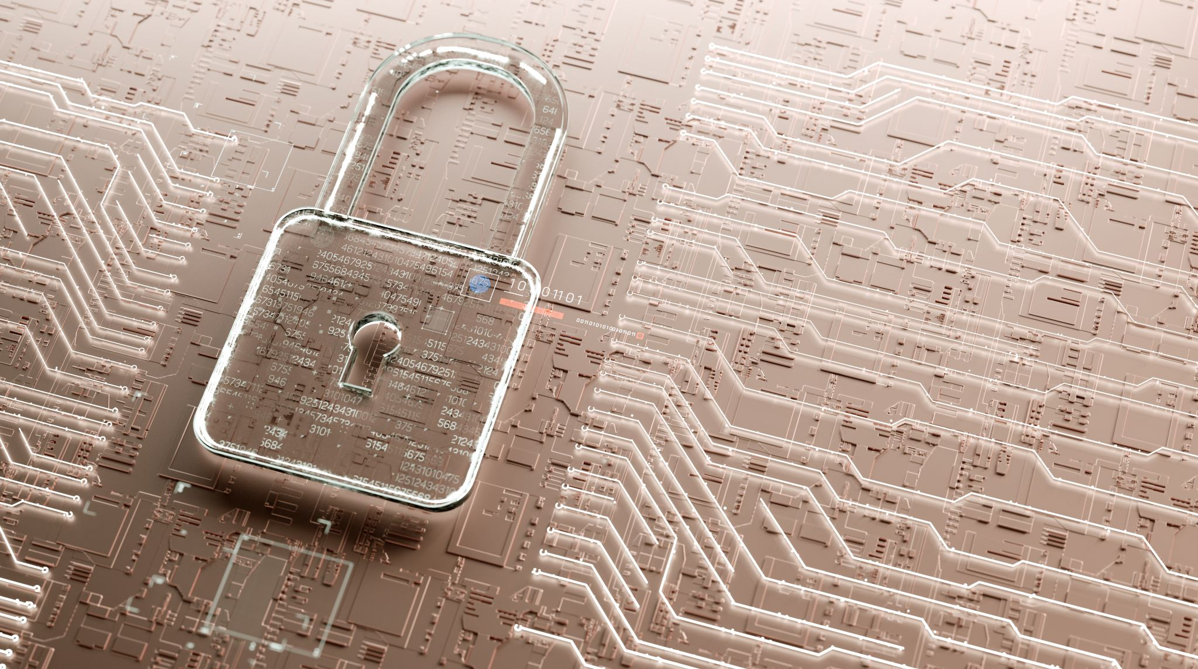
To secure our system, we should:

Slide 12
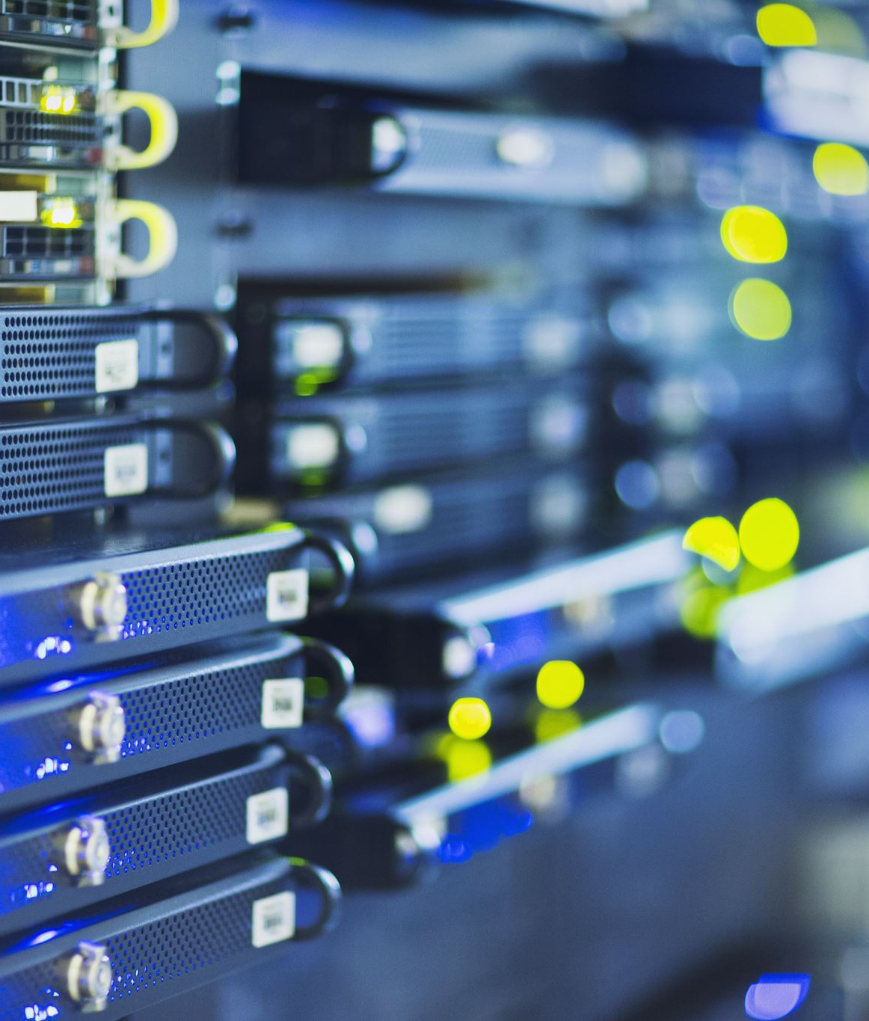
Use a VPN to access the remote desktop or the Minecraft server
Update the system regularly to fix any vulnerabilities
Have a proper backup system

Slide 13

Enable the Minecraft server whitelist and add authorized players
Install a login plugin in Minecraft to prevent unauthorized access
Install a anti cheat plugin

Slide 14

END

